Slide 1
MedicAid
MD Suhaib V
Byleen Janet Roy J
Johna Sam Felix JI
Aishwarya Devi S
Pradheep Vishal L

Slide 2
INTRODUCTION
A comprehensive medical booking platform built using React.js with seamless authentication and role-based functionalities for Admins, Common Users, and Registered Users.

Slide 3
PROJECT OVERVIEW
MedicAid is a web application designed to streamline medical appointments and administrative tasks. With features like booking doctors, managing users, and role-specific functionalities, MedicAid ensures a smooth and efficient experience for all stakeholders. The project leverages modern technologies to deliver a robust and user-friendly platform.

Slide 4
FEATURES
Authentication
Secure login system with role-based access (Admin, Common, and User).
User Functionalities
Book available doctors.
Check doctor availabilities.
View booked appointments.
Common Functionalities
Home Page.
Login and Register functionalities.
Notifications.
Admin Functionalities
Manage Appointments.
Manage Doctors.
Admin Dashboard (Home Page).
Manage Users.

Slide 5
TECH STACK
MERN Stack: MongoDB, Express.js, React.js, Node.js
MongoDB: A NoSQL database that stores data in flexible, JSON-like documents, enabling scalability and high performance.
Express.js: A lightweight, fast, and flexible Node.js web application framework for building APIs and web applications.
React.js: A JavaScript library for building dynamic, interactive user interfaces efficiently with reusable components.
Node.js: A JavaScript runtime for building fast, scalable server-side and networking applications.

Slide 6
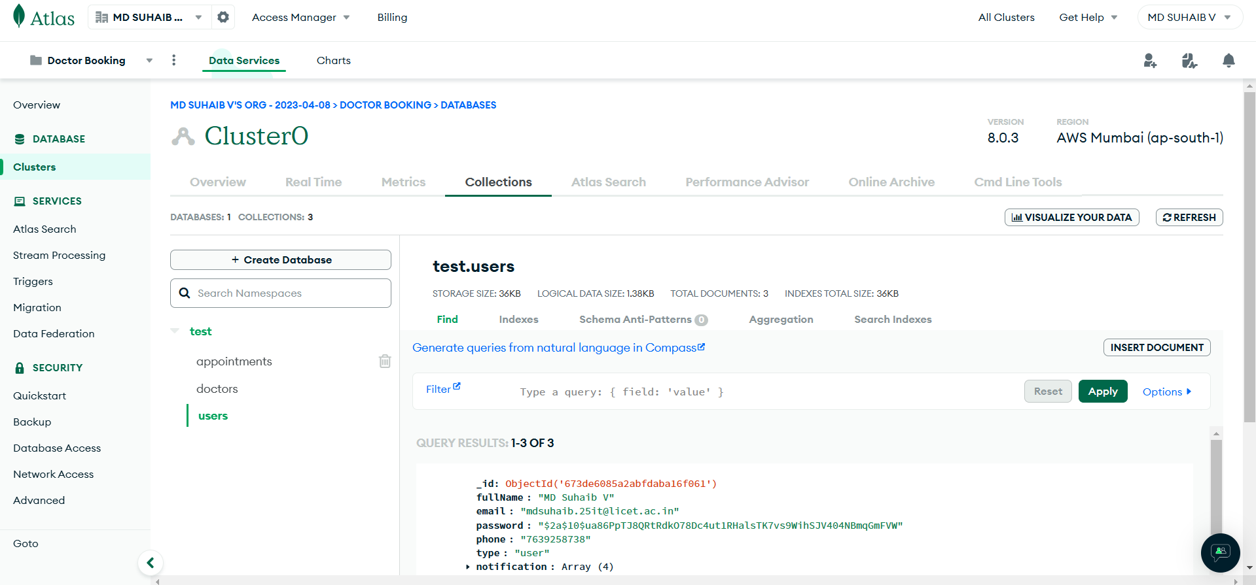
Screenshots
MONGODB ATLAS

Slide 7
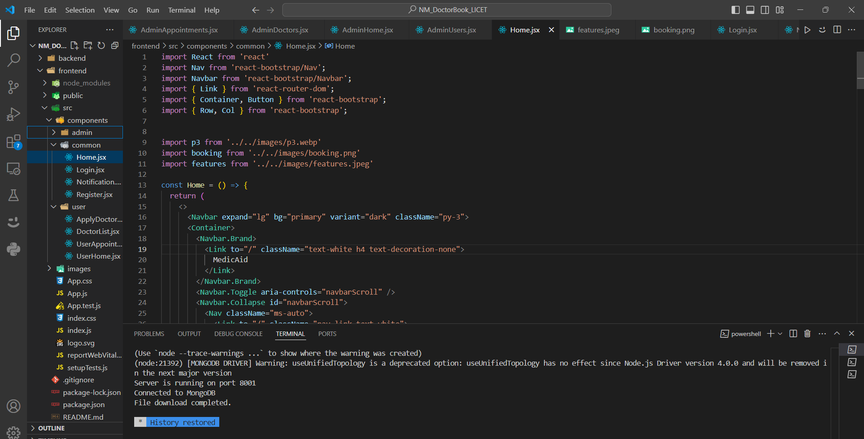
Screenshots
VS CODE

Slide 8
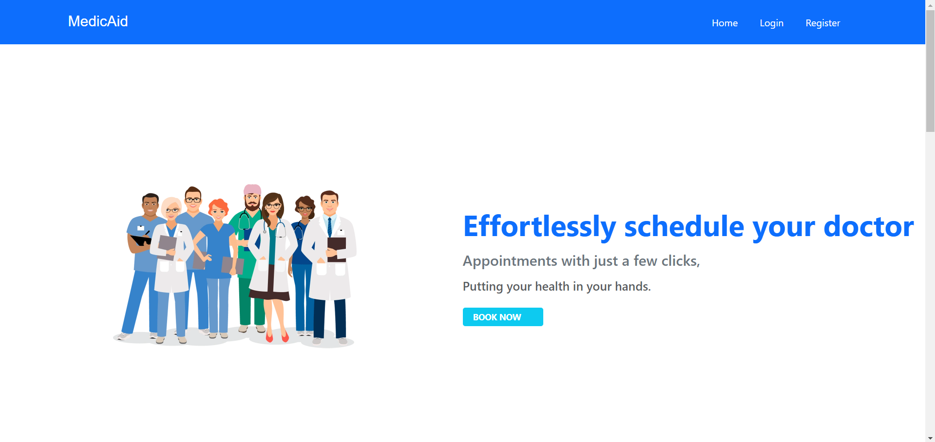
Screenshots
Home Page

Slide 9

Screenshots
About Page

Slide 10
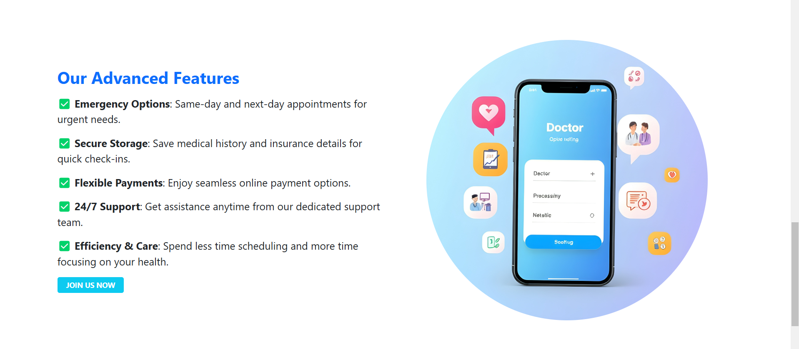
Screenshots
About Page

Slide 11
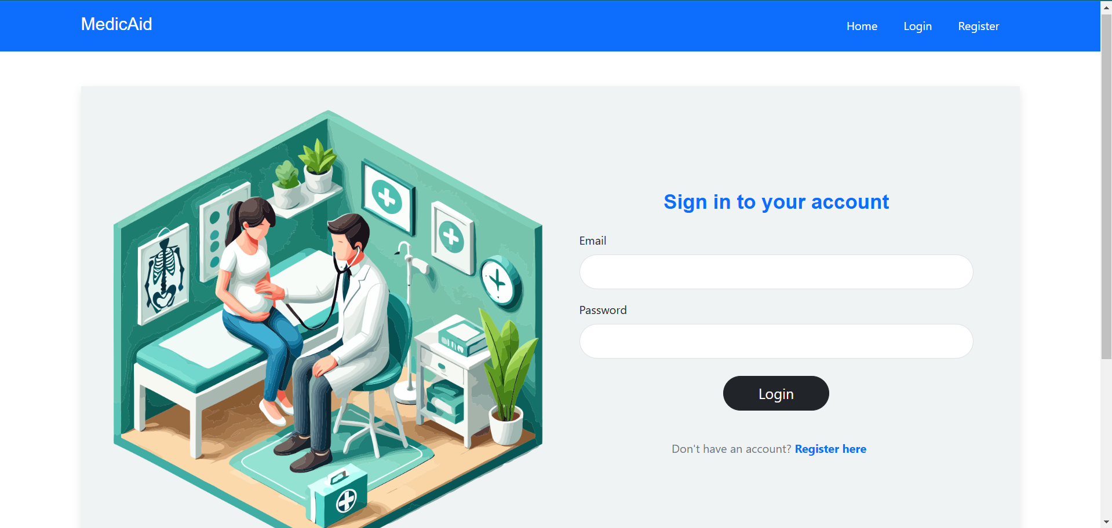
Screenshots
Login Page

Slide 12
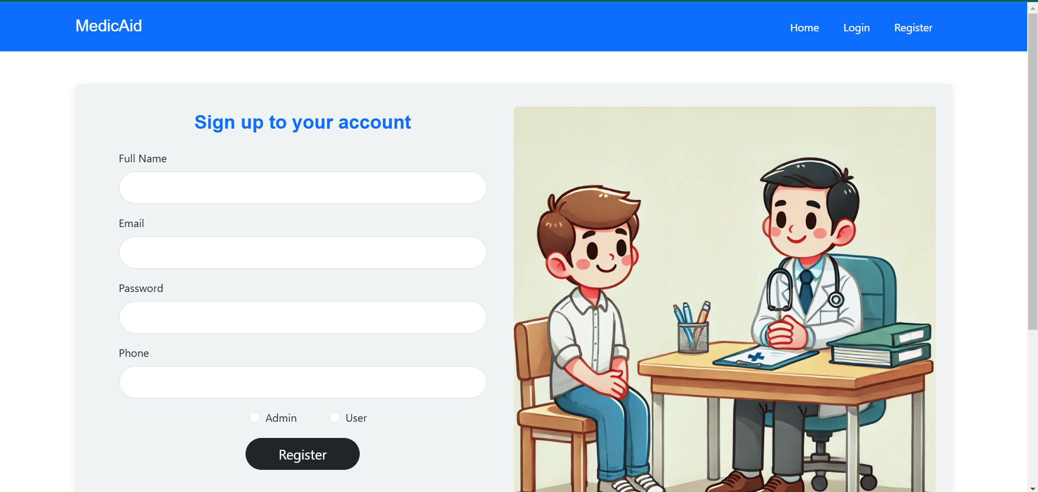
Screenshots
Register Page

Slide 13
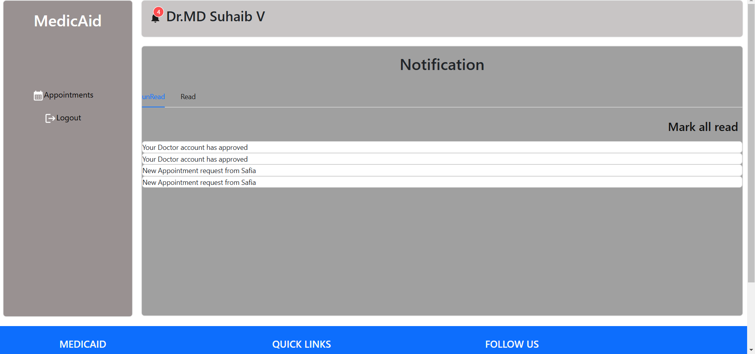
Screenshots
Doctor Home and Notifications

Slide 14
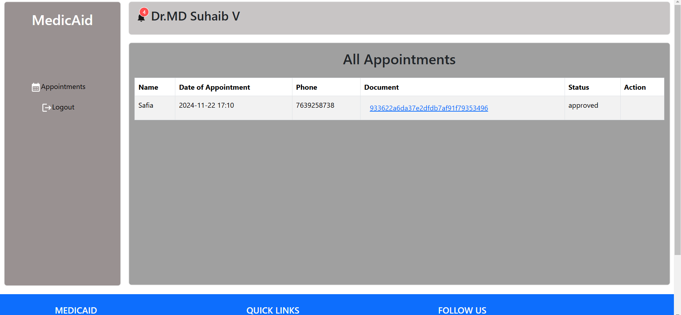
Screenshots
Doctor Appointment Page

Slide 15
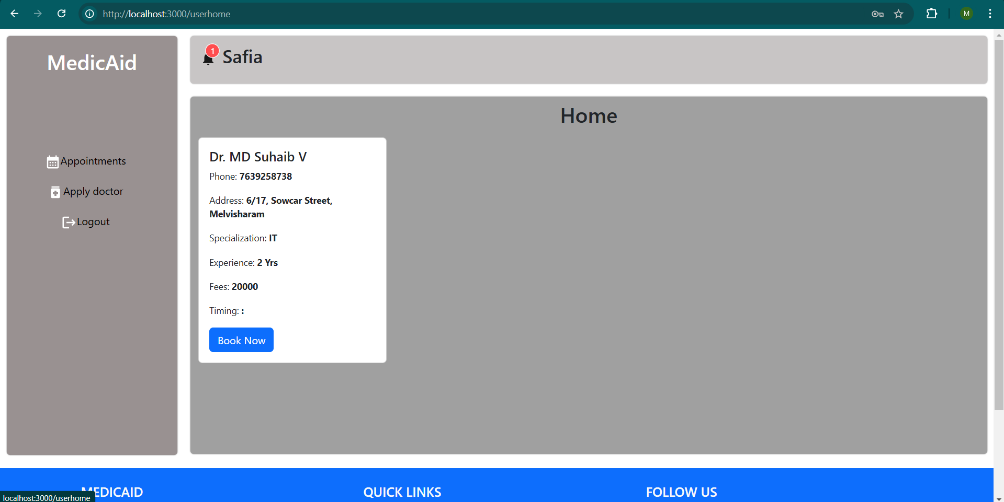
Screenshots
USER HOME PAGE WITH LIST OF AVAILABLE DOCTORS

Slide 16
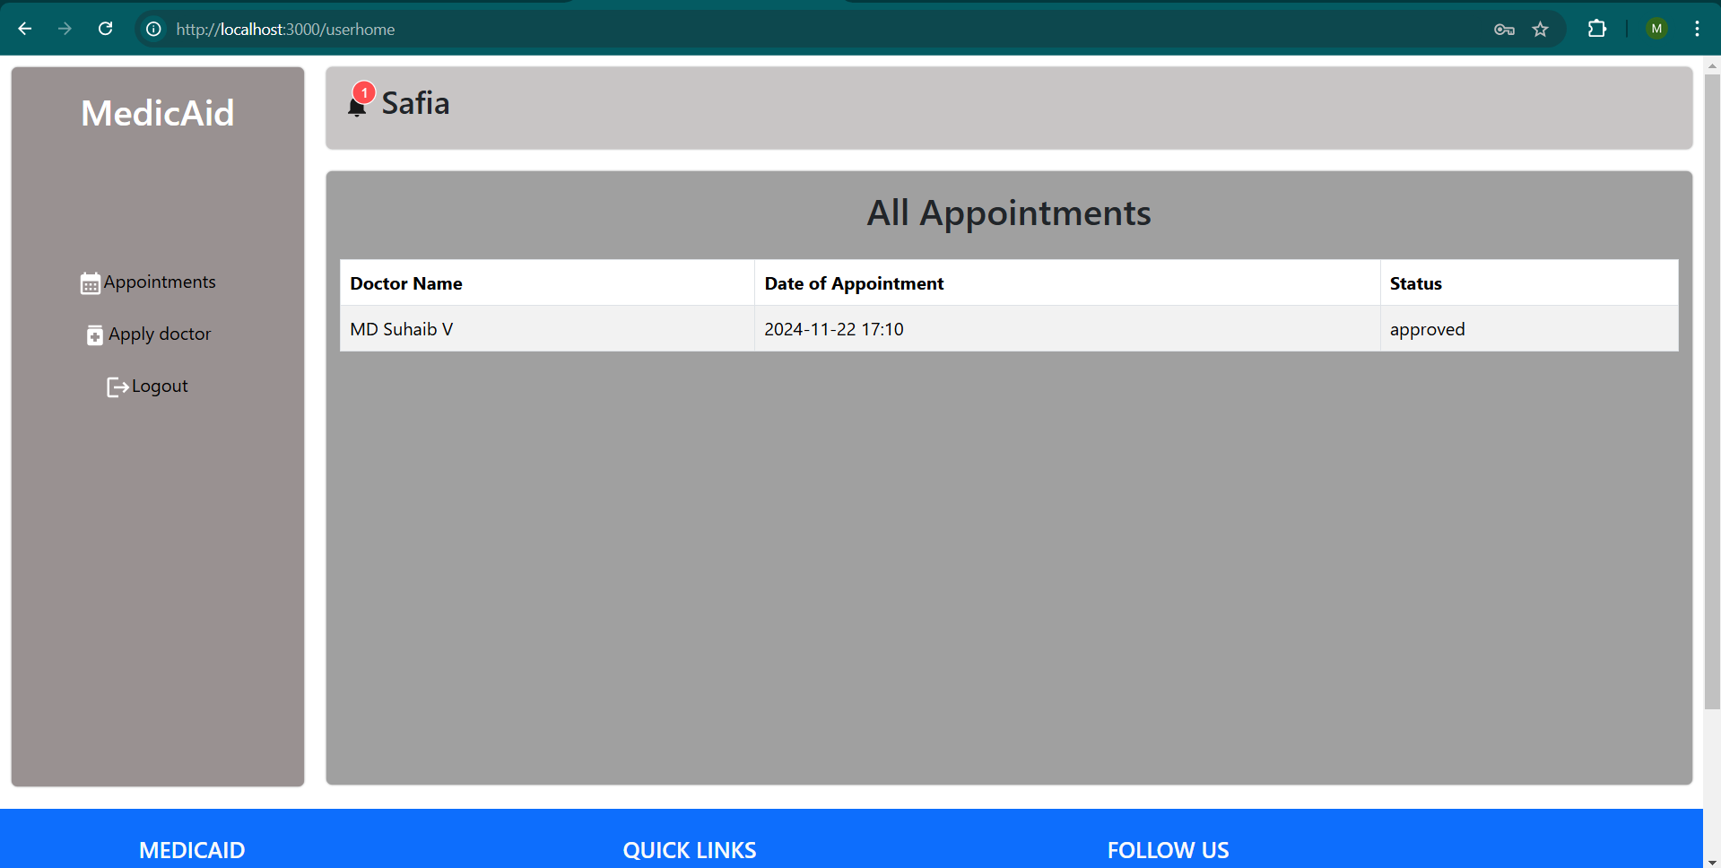
Screenshots
USER APPOINTMENT LIST PAGE

Slide 17
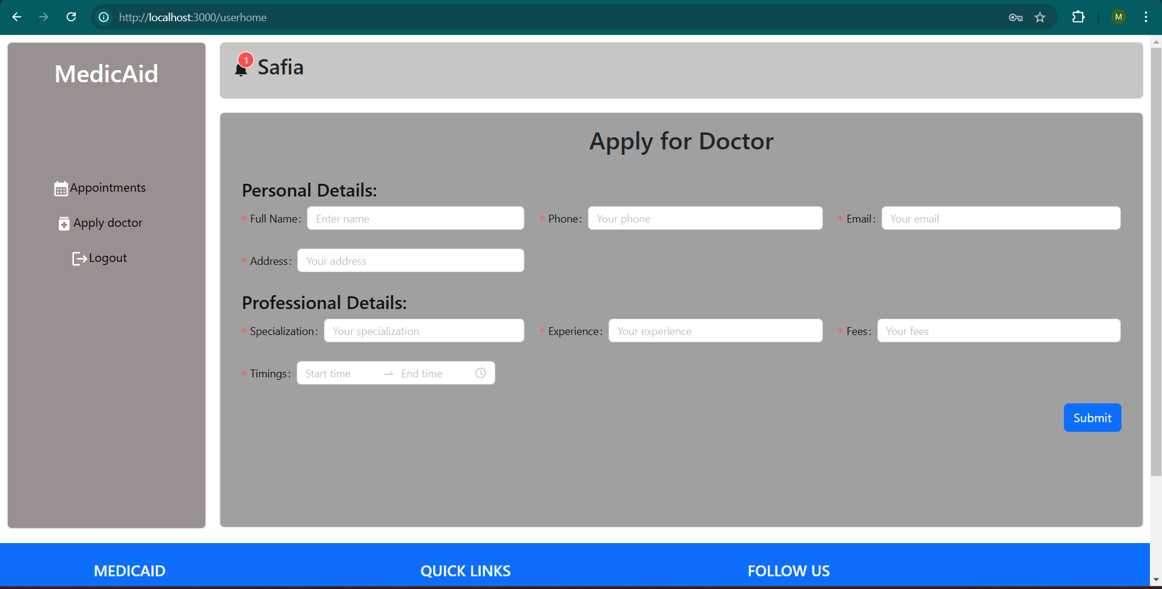
Screenshots
USER PAGE TO APPLY FOR DOCTOR POSITION

Slide 18
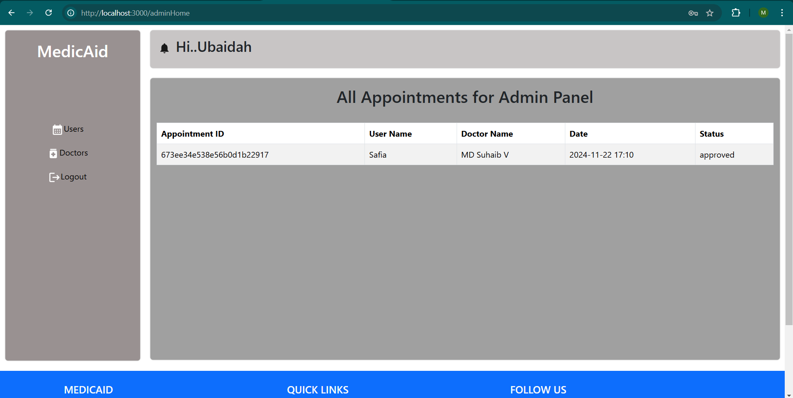
Screenshots
ADMIN HOME PAGE WITH LIST OF APPOINTMENTS

Slide 19
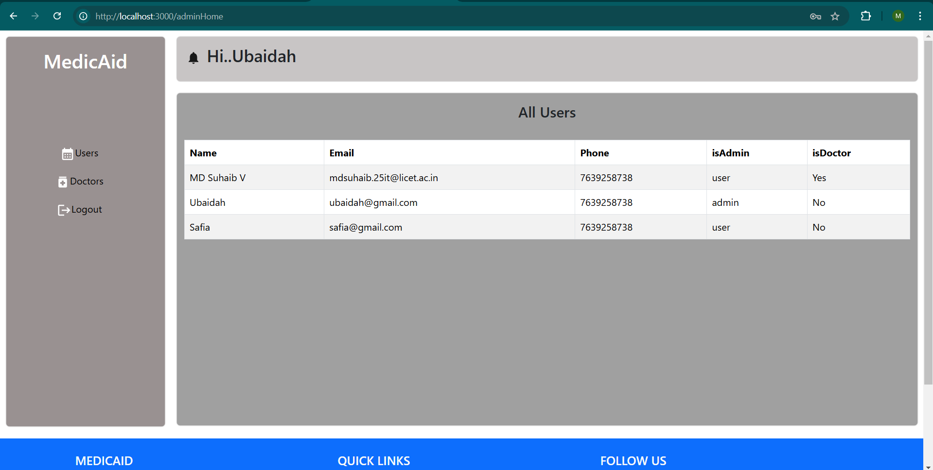
Screenshots
ADMIN PAGE WITH LIST OF ALL USERS AND ROLES

Slide 20
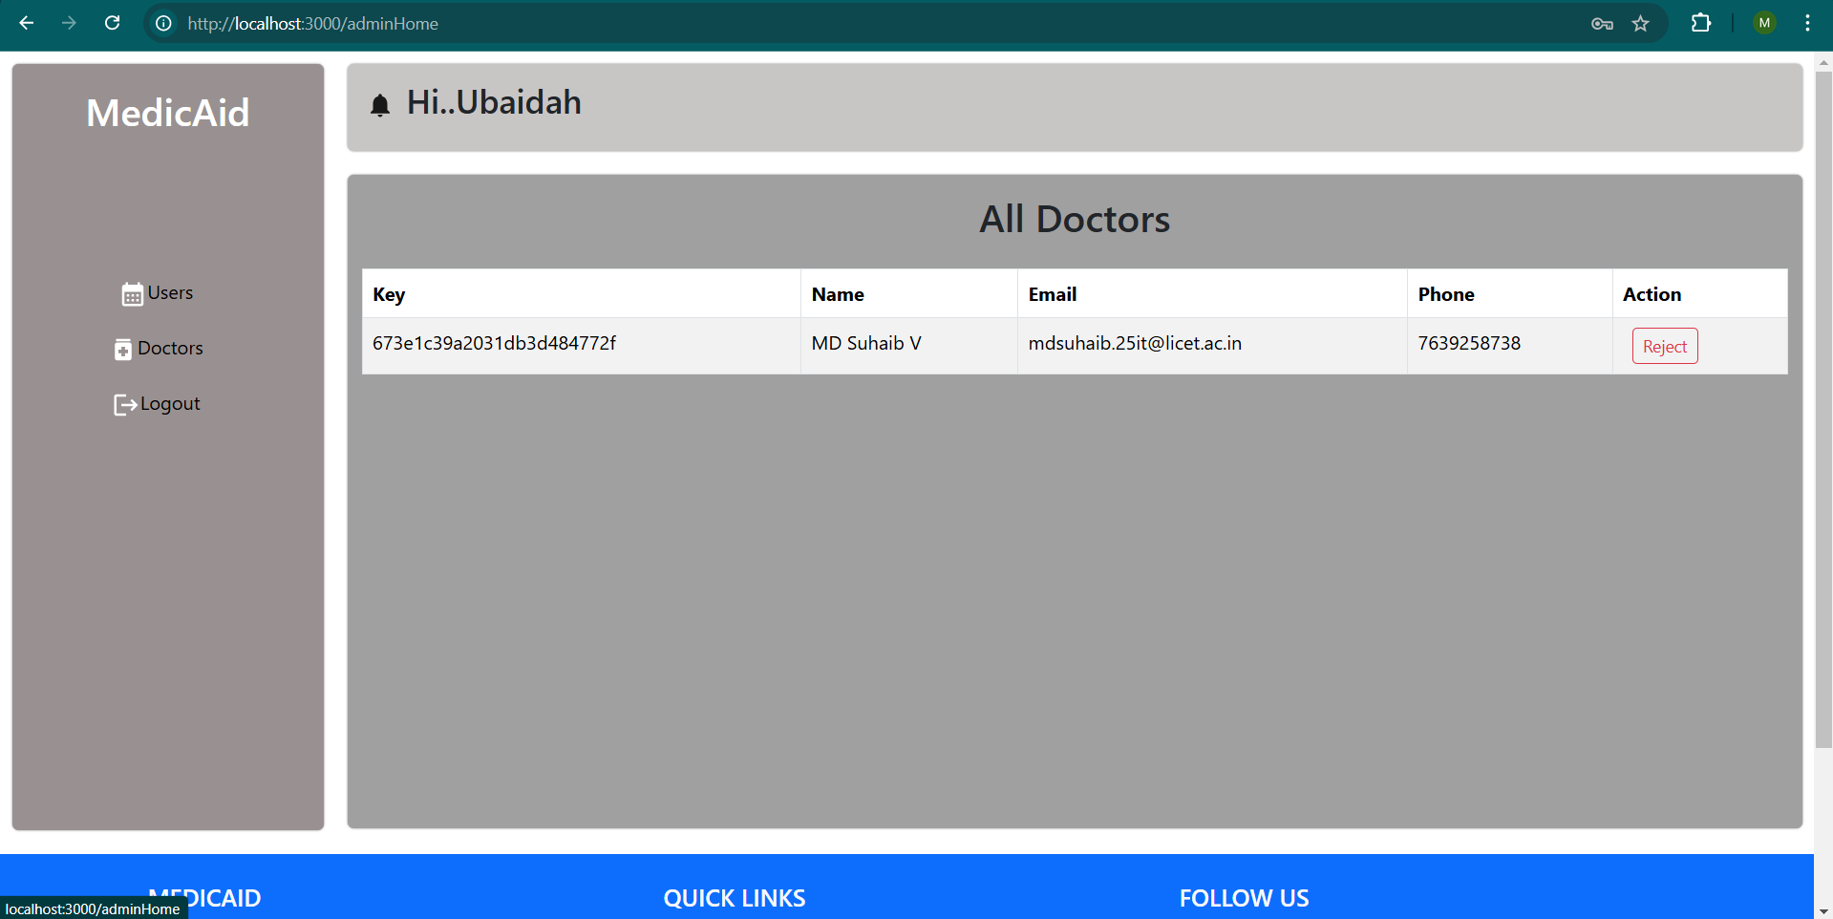
Screenshots
ADMIN PAGE WITH LIST OF DOCTORS

Slide 21
Demonstration

Slide 22
TEAM DETAILS
MD Suhaib V - C0386B3CA0E171FA1AA495F760EC9E82
Byleen Janet Roy J - F2190B664808E4BA263494868ED630BB
Aishwarya Devi S - 3B1ED787E7711409A6A4BB4911B0136A
Johna Sam Felix J I - 05B831181121D75AFE34E48B2F957D86
Pradheep Vishal L - 37C5B4FD4ED29C499184427AB7CF3D3B

Slide 23


